Slide 1
EINBLICK
Notes:
Introduce yourself
Share a story that explains why the AromaTouch Technique is important to you
Distinguish between massage and technique
Tell your students to write down five names by the end of class that they know could benefit from an AromaTouch Technique

Slide 2
„Die AromaTouchTM-Technique
wurde entwickelt,
um den gesundheitlichen Nutzen von ätherischen Ölen zu maximieren.
ABSOLUT SICHER
EINFACH ZU ERLERNEN
HOCH EFFEKTIV
Dr. David K. Hill
Dr. David K. Hill
Chief Medical Officer
Notes:
It’s a wonderful opportunity here to give a personal experience with the AromaTouch!
Dr. Hill did not just throw this technique together, he worked on it for a year and a half. There was a lot of thought and changes that went into making the technique what it is today! Dr. Hill knew that the technique had to be simple enough that anyone could do it! Super simple but extremely powerful. If he was the only one who could do it, the technique couldn’t have reached as many people as it needed to.
The oils were chosen for their physical benefits, emotional benefits, and combined aroma.
We are ALL here to learn - no one will do it perfect the first time. The power is in the simplicity. We are all on the same playing field and we are starting from level 1 together!

Slide 3
DIE ROLLE VON
AROMEN
Notes:
Say that we are first talking about aroma and then move to next slide.
If you want to, you can add in your own example about aroma and how powerful it is…. Example of walking into a bakery and your mouth starts to water just from the aroma alone!

Slide 4
DAS LIMBISCHE SYSTEM
1
Wenn wir einen Geruch wahrnehmen, trifft er auf unseren Riechnerv in der Nasenhöhle.
Der Nerv sendet dann eine direkte Nachricht an das limbische System.
2
die in der Natur vorhandenen ätherischen Partikel durchschreiten die Blut-Hirn-Schranke!
Notes:
We know there is a direct correlation between emotional and physical connections. That is why the aroma of each of these oils and blends is so critical to the success of the ATT.
Going into the detail about the limbic system above and relating it back to your story or the slide about oranges and cinnamon
Many of you will notice if you haven’t already experienced the AromaTouch, that you experience a completely different aroma because of the layering that goes on to make it an even more unique experience. Many people have tried to recreate the aroma of the AromaTouch Technique in a bottle and it didn’t work because it is not the same as layering the oils one by one like we do in the technique.

Slide 5
DIE ROLLE VON
BERÜHRUNGEN
Notes:
The Nervous System of the Body responds to touch in a profound way. There was a study that found that the lighter the touch, the more heightened the response from the nervous system was!
This is where we need to reinforce how the touch needs to be! Light Touch vs Massage and Confident Touch vs Deep Tissue
Example of when you feel something that you don’t even see because your neurological feedback is stimulated more powerfully
This is what sets it apart – this type of touch

Slide 6
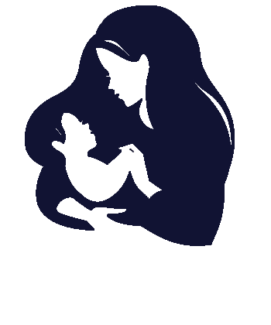
BERÜHRUNGEN ERZEUGEN BINDUNG
Berührungen stimulieren unseren Körper.
DEN BLUTDRUCK SENKEN
DIE HERZFREQUENZ SENKEN
DEN CORTISOLSPIEGEL SENKEN
Körper, Geist und Emotionen reagieren.
Notes:
Our goal is to create an opportunity for a connection to form through safe touch.
Modesty | Comfort | Safety - All of these things need to be present in order to produce the positive results we want from the ATT.

Slide 7
DIE ROLLE VON
MERIDIANEN + ENERGIEZONEN
Notes:
The Nervous System of the Body responds to touch in a profound way. There was a study that found that the lighter the touch, the more heightened the response from the nervous system was!
This is where we need to reinforce how the touch needs to be! Light Touch vs Massage and Confident Touch vs Deep Tissue
Example of when you feel something that you don’t even see because your neurological feedback is stimulated more powerfully
This is what sets it apart – this type of touch

Slide 8
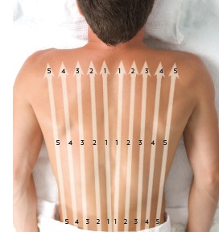
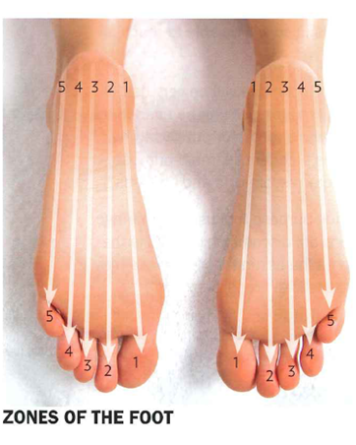
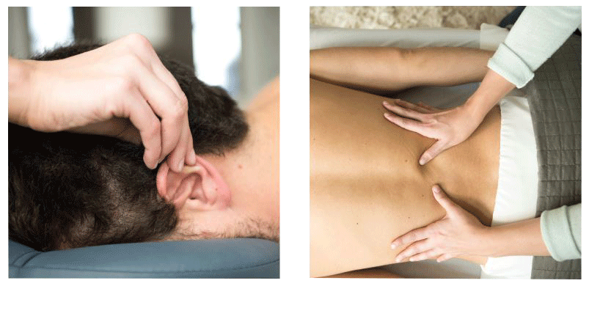
Notes:
Our bodies neurological processes are constantly in flux. What we are talking about is the Autonomic Nervous System. It impacts every function of our body. We don’t consider it or talk about it because it is automatic and yet it impacts our everyday wellness and health. Our hearts automatically beat, our eyes naturally blink, we naturally breathe air… This is the Parasympathetic Nervous System or “Rest and Digest” part of the nervous system. The other side of our nervous system is the Sympathetic Nervous System which is our “Fight or Flight” response when our body is feeling threatened, etc.
Our bodies are constantly fluctuating between the two everyday every second. The problem is when we are out of balance, our bodies may be functioning more in one or the other rather than the two being in harmony with each other. How many of you know someone suffering some major digestive issues? AND they are constantly under intense stress? Have you ever considered the fact that their autonomic nervous system is out of balance therefore their parasympathetic “rest and digest” is not functioning the way it should?
We are addressing these two sides of the nervous system through the AromaTouch Technique which means we are able to help the body get the reset it deserves. Our bodies are able to heal themselves when they are in a state of homeostasis.
Example: Hanging a picture and using a level, we want the bubble to be in the middle as often and as long as possible!

Slide 9
DIE ROLLE VON
RHYTHMUS & WIEDERHOLUNG
Notes:
The Nervous System of the Body responds to touch in a profound way. There was a study that found that the lighter the touch, the more heightened the response from the nervous system was!
This is where we need to reinforce how the touch needs to be! Light Touch vs Massage and Confident Touch vs Deep Tissue
Example of when you feel something that you don’t even see because your neurological feedback is stimulated more powerfully
This is what sets it apart – this type of touch

Slide 10
UNSER KÖRPER
LIEBT RHYTHMUS
Notes:
Our bodies neurological processes are constantly in flux. What we are talking about is the Autonomic Nervous System. It impacts every function of our body. We don’t consider it or talk about it because it is automatic and yet it impacts our everyday wellness and health. Our hearts automatically beat, our eyes naturally blink, we naturally breathe air… This is the Parasympathetic Nervous System or “Rest and Digest” part of the nervous system. The other side of our nervous system is the Sympathetic Nervous System which is our “Fight or Flight” response when our body is feeling threatened, etc.
Our bodies are constantly fluctuating between the two everyday every second. The problem is when we are out of balance, our bodies may be functioning more in one or the other rather than the two being in harmony with each other. How many of you know someone suffering some major digestive issues? AND they are constantly under intense stress? Have you ever considered the fact that their autonomic nervous system is out of balance therefore their parasympathetic “rest and digest” is not functioning the way it should?
We are addressing these two sides of the nervous system through the AromaTouch Technique which means we are able to help the body get the reset it deserves. Our bodies are able to heal themselves when they are in a state of homeostasis.
Example: Hanging a picture and using a level, we want the bubble to be in the middle as often and as long as possible!

Slide 11
DIE ROLLE VON
LAYERING
Notes:
The Nervous System of the Body responds to touch in a profound way. There was a study that found that the lighter the touch, the more heightened the response from the nervous system was!
This is where we need to reinforce how the touch needs to be! Light Touch vs Massage and Confident Touch vs Deep Tissue
Example of when you feel something that you don’t even see because your neurological feedback is stimulated more powerfully
This is what sets it apart – this type of touch

Slide 12
NACHEINANDER
ÖLE AUFTRAGEN
vs.
ALLE AUF EINMAL
Notes:
Our bodies neurological processes are constantly in flux. What we are talking about is the Autonomic Nervous System. It impacts every function of our body. We don’t consider it or talk about it because it is automatic and yet it impacts our everyday wellness and health. Our hearts automatically beat, our eyes naturally blink, we naturally breathe air… This is the Parasympathetic Nervous System or “Rest and Digest” part of the nervous system. The other side of our nervous system is the Sympathetic Nervous System which is our “Fight or Flight” response when our body is feeling threatened, etc.
Our bodies are constantly fluctuating between the two everyday every second. The problem is when we are out of balance, our bodies may be functioning more in one or the other rather than the two being in harmony with each other. How many of you know someone suffering some major digestive issues? AND they are constantly under intense stress? Have you ever considered the fact that their autonomic nervous system is out of balance therefore their parasympathetic “rest and digest” is not functioning the way it should?
We are addressing these two sides of the nervous system through the AromaTouch Technique which means we are able to help the body get the reset it deserves. Our bodies are able to heal themselves when they are in a state of homeostasis.
Example: Hanging a picture and using a level, we want the bubble to be in the middle as often and as long as possible!

Slide 13
DIE ROLLE DER
INHALSTSTOFFE
Notes:
The Nervous System of the Body responds to touch in a profound way. There was a study that found that the lighter the touch, the more heightened the response from the nervous system was!
This is where we need to reinforce how the touch needs to be! Light Touch vs Massage and Confident Touch vs Deep Tissue
Example of when you feel something that you don’t even see because your neurological feedback is stimulated more powerfully
This is what sets it apart – this type of touch

Slide 14
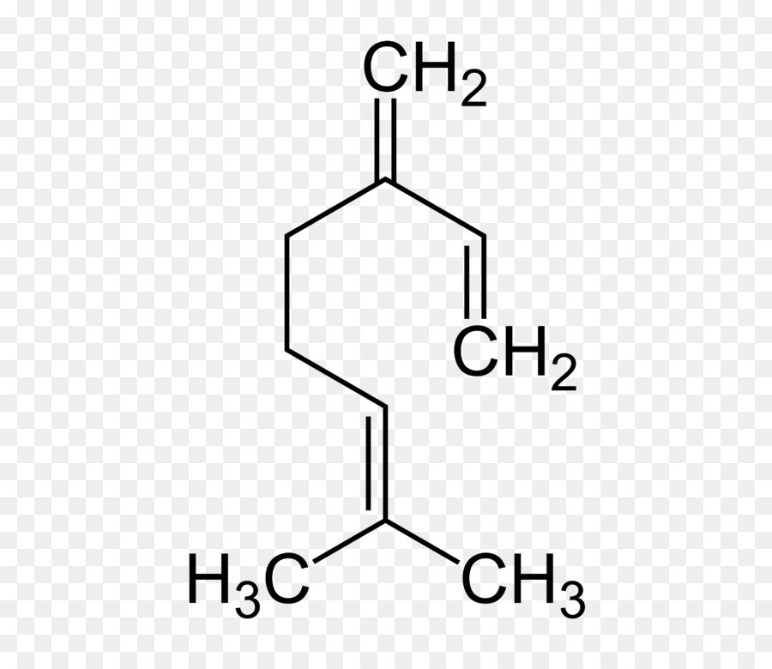
REINHEIT IST ENTSCHEIDEND
MONOTERPENE
Notes:
Our bodies neurological processes are constantly in flux. What we are talking about is the Autonomic Nervous System. It impacts every function of our body. We don’t consider it or talk about it because it is automatic and yet it impacts our everyday wellness and health. Our hearts automatically beat, our eyes naturally blink, we naturally breathe air… This is the Parasympathetic Nervous System or “Rest and Digest” part of the nervous system. The other side of our nervous system is the Sympathetic Nervous System which is our “Fight or Flight” response when our body is feeling threatened, etc.
Our bodies are constantly fluctuating between the two everyday every second. The problem is when we are out of balance, our bodies may be functioning more in one or the other rather than the two being in harmony with each other. How many of you know someone suffering some major digestive issues? AND they are constantly under intense stress? Have you ever considered the fact that their autonomic nervous system is out of balance therefore their parasympathetic “rest and digest” is not functioning the way it should?
We are addressing these two sides of the nervous system through the AromaTouch Technique which means we are able to help the body get the reset it deserves. Our bodies are able to heal themselves when they are in a state of homeostasis.
Example: Hanging a picture and using a level, we want the bubble to be in the middle as often and as long as possible!

Slide 15
UNSERE ALLGEMEINE
GESUNDHEIT
Notes:
- Let’s now talk about how the technique benefits our overall health (skip to next slide)

Slide 16
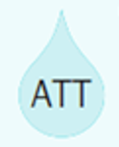
HOMÖOSTASE
Systemische Konstanten
Faktoren, die Einfluss auf die Homöostase haben
1
1
Stress
Stress Management
4
2
4
2
Autonomes Ungleichgewicht
Immunsystem geschwächt
Homöostasis
Immunsystem gestärkt
3
3
Entzündung
Gesunde Entzündungs-Reaktion
Notes:
Our bodies neurological processes are constantly in flux. What we are talking about is the Autonomic Nervous System. It impacts every function of our body. We don’t consider it or talk about it because it is automatic and yet it impacts our everyday wellness and health. Our hearts automatically beat, our eyes naturally blink, we naturally breathe air… This is the Parasympathetic Nervous System or “Rest and Digest” part of the nervous system. The other side of our nervous system is the Sympathetic Nervous System which is our “Fight or Flight” response when our body is feeling threatened, etc.
Our bodies are constantly fluctuating between the two everyday every second. The problem is when we are out of balance, our bodies may be functioning more in one or the other rather than the two being in harmony with each other. How many of you know someone suffering some major digestive issues? AND they are constantly under intense stress? Have you ever considered the fact that their autonomic nervous system is out of balance therefore their parasympathetic “rest and digest” is not functioning the way it should?
We are addressing these two sides of the nervous system through the AromaTouch Technique which means we are able to help the body get the reset it deserves. Our bodies are able to heal themselves when they are in a state of homeostasis.
Example: Hanging a picture and using a level, we want the bubble to be in the middle as often and as long as possible!

Slide 17
DIE ÖLE FÜR DIE AROMATOUCHTM -TECHNIQUE
Notes:
- Let’s talk our amazing 8 oils! (skip to next slide)

Slide 18
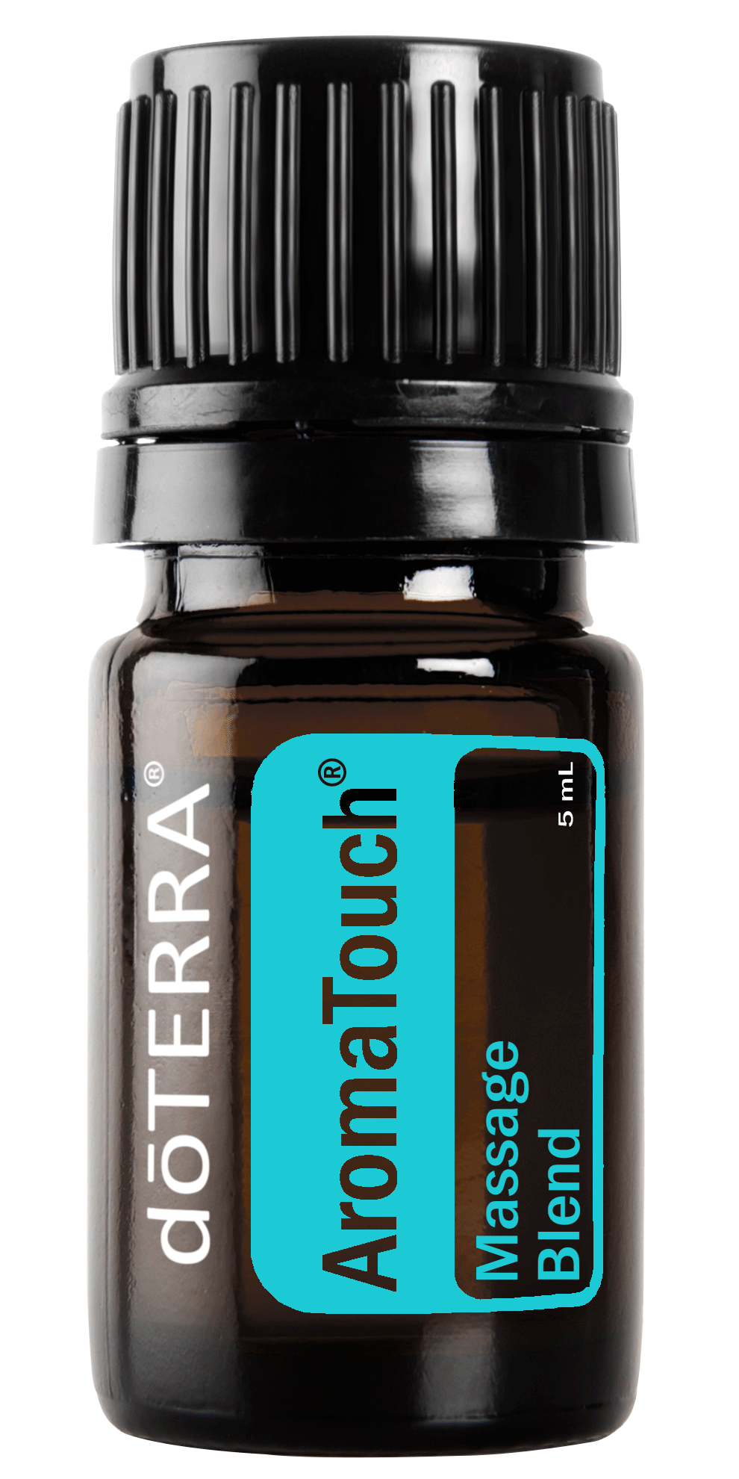
Notes:
One of the most important things to remember is that we always use doTERRA oils and we don’t ever substitute or add any other oils. If someone is dealing with something specific, you can give them the technique and then use other oils in different ways outside of the technique but the technique stays the way it is.
Talk about the integrity of the technique. One of the reasons why you are here is to learn the right way to do the technique! Out in the field, there might be adaptations of the technique but in this training, you will learn the proper way to use the technique so that you can be confident with your delivery and that you are truly helping people by giving them the technique the right way.

Slide 19
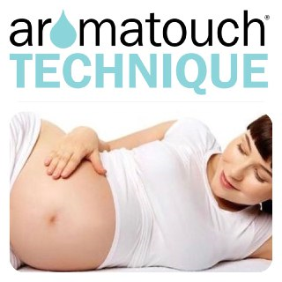
Notes:
Associated with Pg 10 in the Manual. At this point in time, have your demo be getting ready on the table to start the instructional demo (Movements Individually First, then the AromaTouch Technique All the Way Through).
Explain that you will be going through each movement on its own and then showing them an AromaTouch Technique all the way through. The reason why you are doing that is because there are some words and terms that you may not have heard before that I will be using over and over again throughout the rest of the day that you want to make sure they know.
There are also some tips and tricks that will make the technique super simple and easier to remember what comes next that we will go through now so that when you go into rotations, you will be confident and ready to perform the technique yourselves.

Slide 20
ABSOLUT SICHER
EINFACH ZU ERLERNEN
HOCH EFFEKTIV
Notes:
It’s a wonderful opportunity here to give a personal experience with the AromaTouch!
Dr. Hill did not just throw this technique together, he worked on it for a year and a half. There was a lot of thought and changes that went into making the technique what it is today! Dr. Hill knew that the technique had to be simple enough that anyone could do it! Super simple but extremely powerful. If he was the only one who could do it, the technique couldn’t have reached as many people as it needed to.
The oils were chosen for their physical benefits, emotional benefits, and combined aroma.
We are ALL here to learn - no one will do it perfect the first time. The power is in the simplicity. We are all on the same playing field and we are starting from level 1 together!

